Slide 1

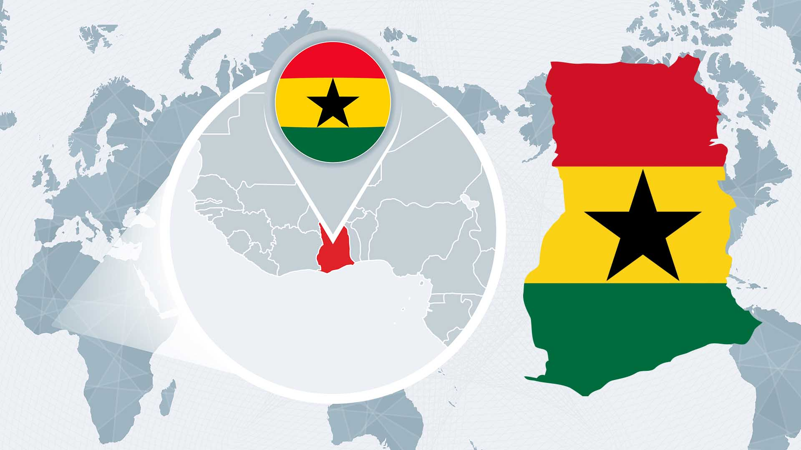
The Gulf of Guinea Northern Regions Social Cohesion (SOCO) Project, Ghana
“Thinking Regionally, Acting Locally”
Examining the Drivers of Fragility, Conflict, and Violence in Northern Ghana
REGIONAL FORUM ON GOVERNANCE AND SOCIAL COHESION, GULF OF GUINEA REGION
February 4–6, 2024, Palais des Congrès, Cotonou, Benin
www. https://soco.gov.gh/ | @SOCOProject | https://www.facebook.com/SOCOprojectgh

Slide 2
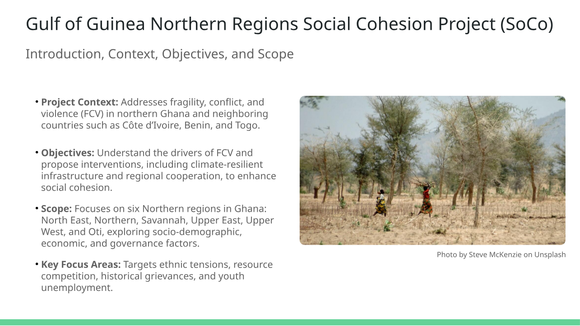

Slide 3
Study Methodology
Mixed-Methods Approach
Data Collection
Data Analysis
Quantitative Survey Structured Questionnaire
Qualitative Focus Group Discussions
Quantitative Analysis
- Descriptive statistics
- Shi-square tests
- Binary regression
Qualitative Analysis
- Thematic patterns in FCV
Multistage Sampling
- Stratified Random Sampling
- Six regions
- 210 respondents

Slide 4
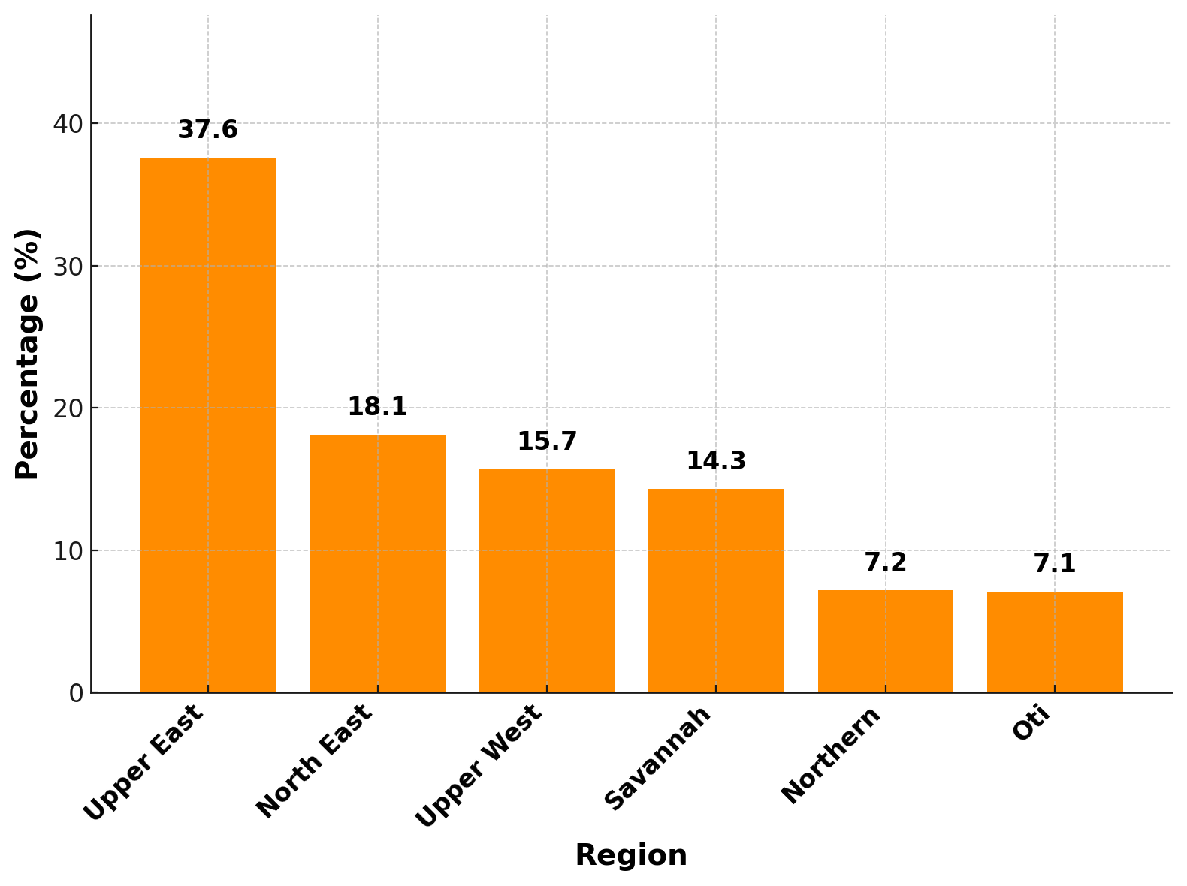
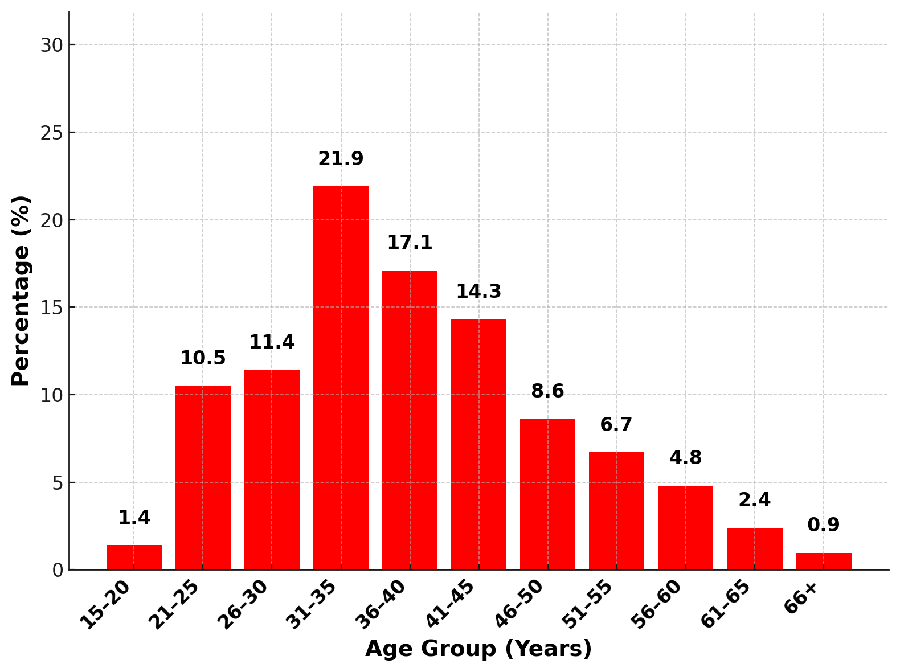
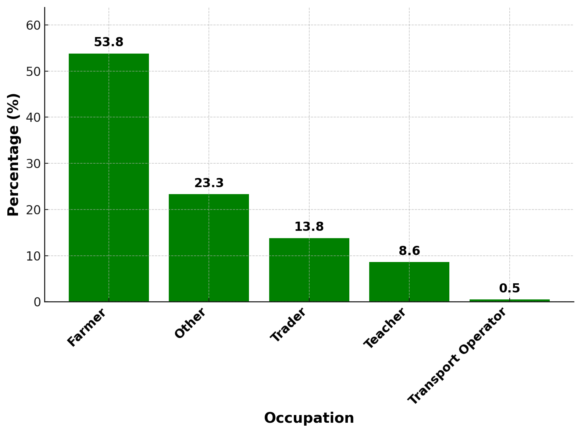
Regional Representation
Upper East has the highest respondents (37.6%), followed by North East (18.1%) and Upper West (15.7%).
Gender and Age Distribution
62.9% of respondents are male; the most represented age group is 31–35 years (21.9%).
Representation Context
Rural context dominates, with agriculture being a primary livelihood source.
Dominant Occupations
Farmers comprise 53.8%, with traders (13.8%) and teachers (8.6%) following.

Slide 5
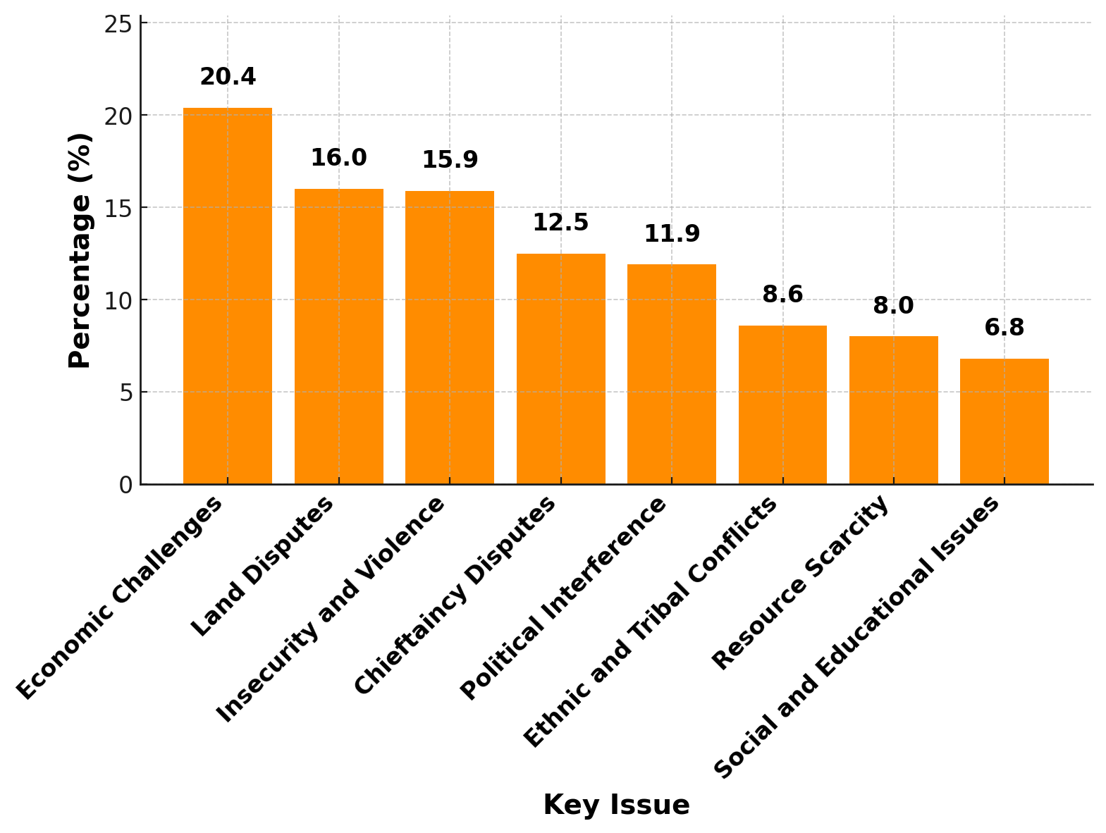
Economic Challenges: Youth unemployment (20.4%) promotes extremist vulnerabilities; rural economies lack resilience.
Land Disputes: 16% cite disputes driven by resource scarcity, with farmer-herder conflicts worsening tensions.
Insecurity and Violence: 15.9% report organized violence linked to Sahel terrorism, crime, and political unrest.
Chieftaincy Disputes: 12.5% highlight leadership struggles over succession, fracturing communities and governance.
Political Interference: 11.9% associate election-period manipulation with ethnic tensions and rivalry intensification.
Ethnic and Tribal Tensions: 8.6% of conflicts stem from historical ethnic divides, worsened by identity-based discrimination.
Resource Scarcity: 8% report violent clashes over scarce water and land resources during droughts.
Social and Educational Issues: 6.8% cite inequality in education and exclusion of Fulbes and PWDs as sources of marginalization.
Dynamics of Fragility, Conflict, and Violence (FCV) - Key Drivers

Slide 6
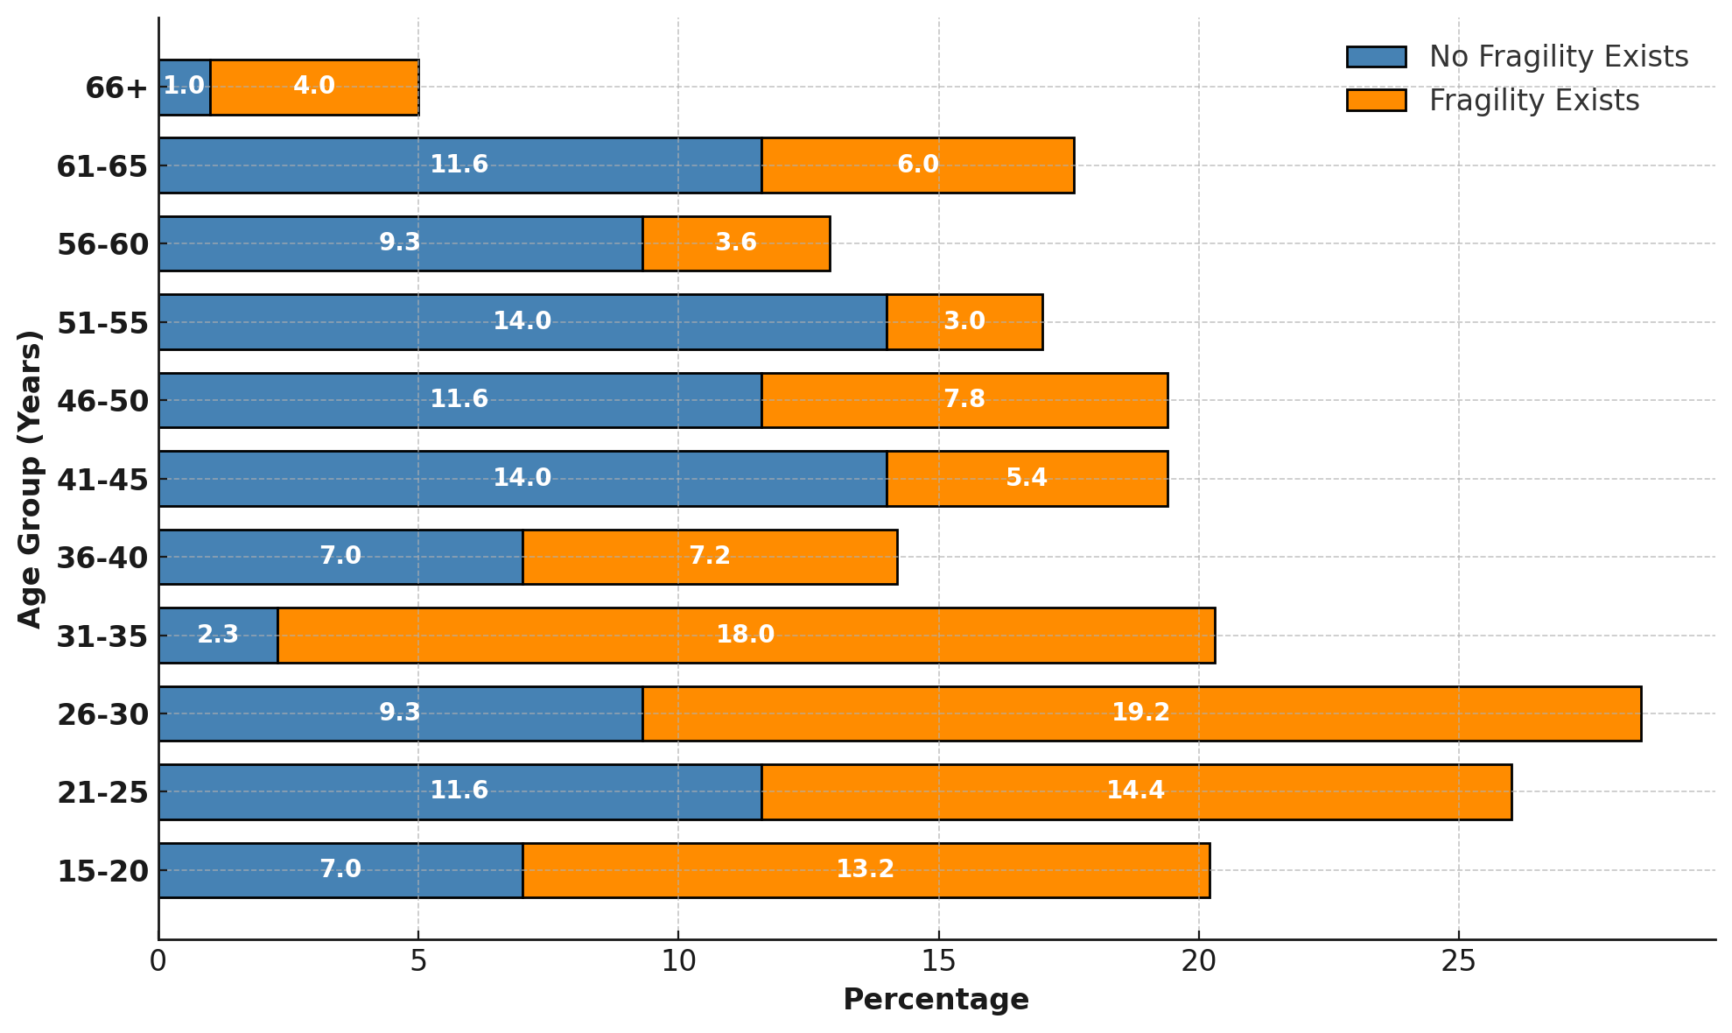
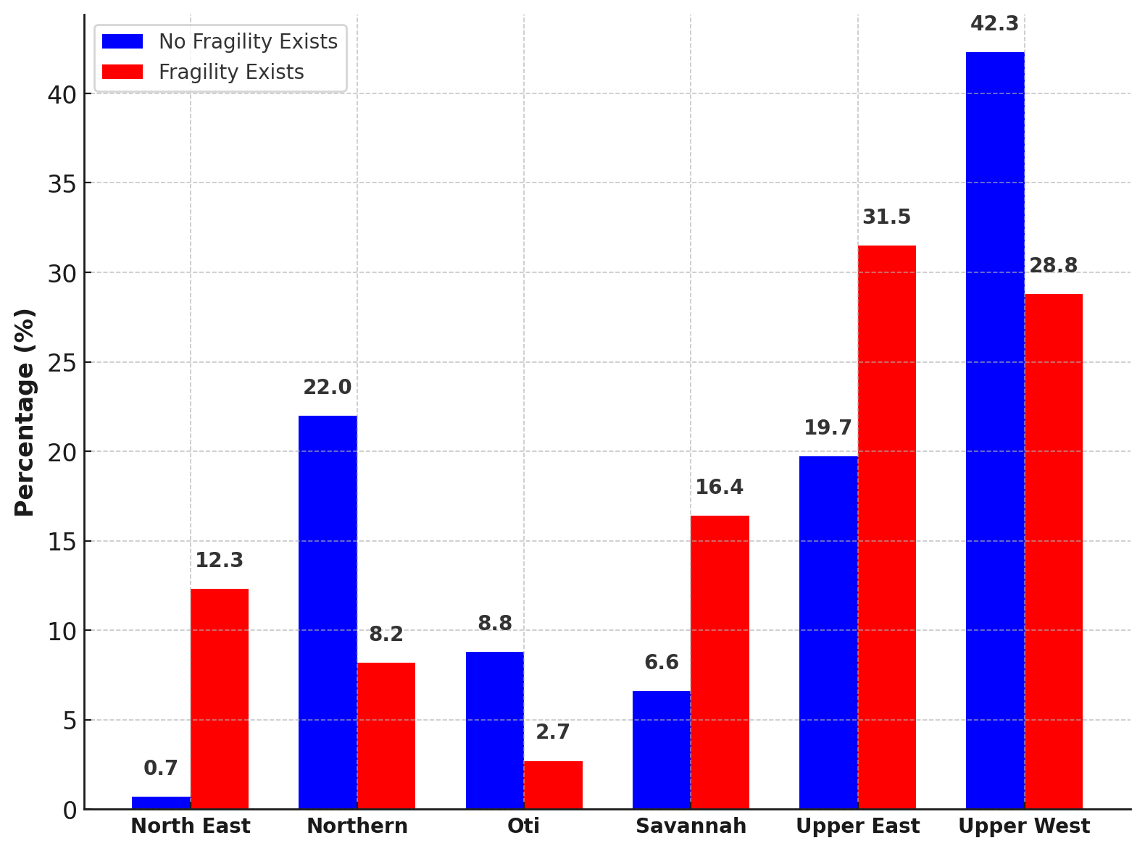
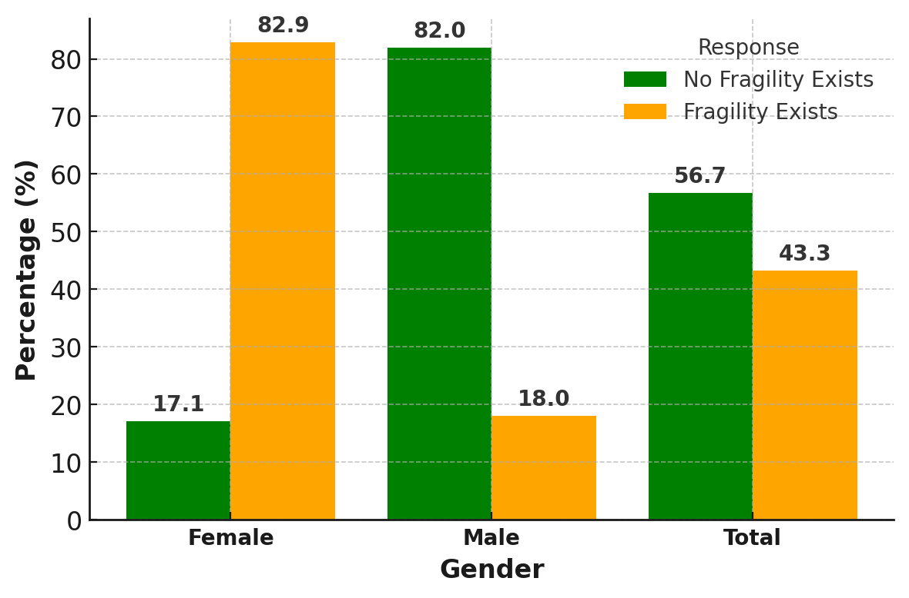
Fragility, Conflict, and Violence (FCV)
Explaining Key Perceptions and Variations
Age Group Perception
Youth (15–35) report higher fragility due to unemployment, conflict exposure, and lack of resilience (χ² = 18.289, p = 0.018).
Regional Differences
Upper East/West face fragility due to proximity to Sahel terrorism, resource scarcity, and historical tensions (χ² = 20.350, p = 0.061).
Women’s Heightened Vulnerability
82.9% cite caregiving burdens, resource access barriers, and gendered violence as major factors (χ² = 0.953, p = 0.021).
Men’s Focus on Governance
Men (18%) perceive fragility through political power struggles and governance challenges.

Slide 7
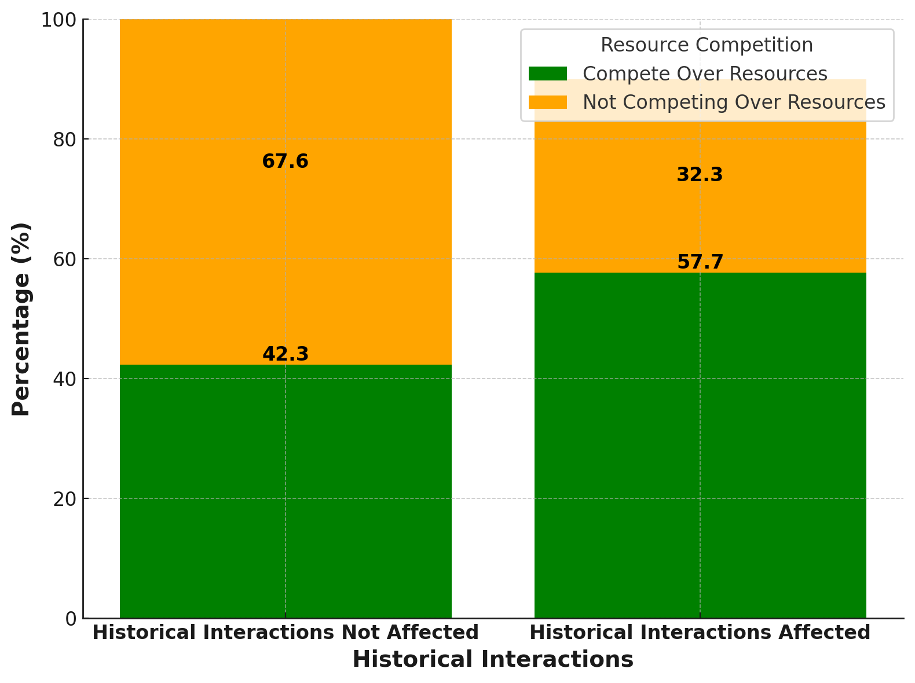
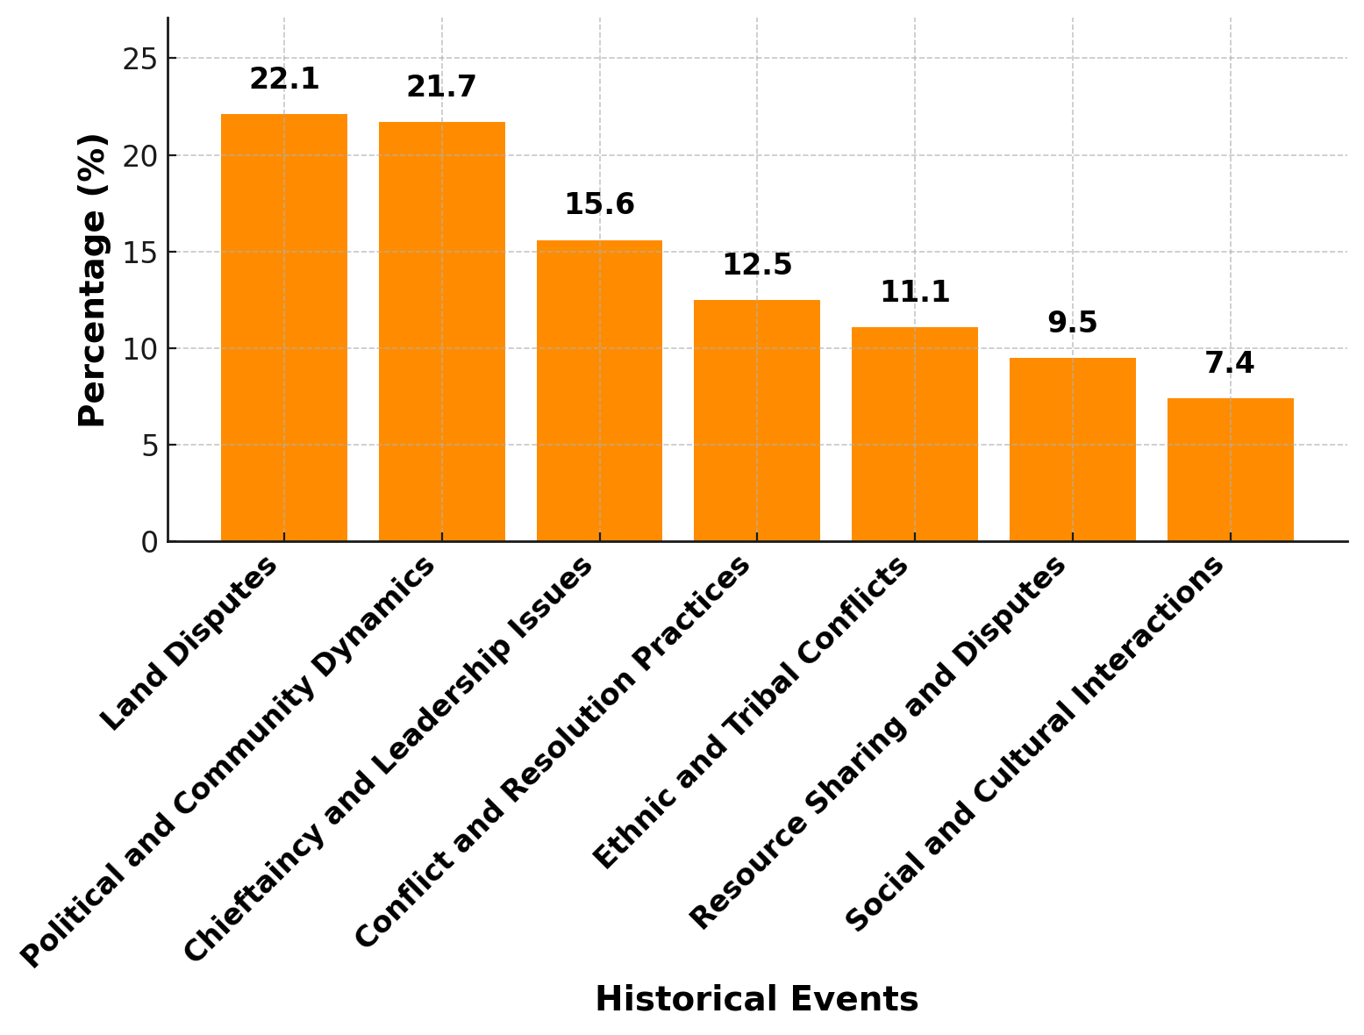
Fragility, Conflict, and Violence (FCV)
Historical Interactions and Community Dynamics
Statistical Findings: Chi-Square results (χ² = 137.651, df = 4, p = 0.000) reveal a significant link between historical interactions and current resource competition. Communities with ethnic conflicts face 74.6% likelihood of competition over land and water.
Historical Land Disputes: 22.1% of respondents attribute current conflicts to unresolved land disputes. Long-standing issues between groups like Kusasis and Mamprusis remain persistent, fueling divisions and tension over market locations and land ownership.
Political and Community Rivalries: 21.7% cited historical political disputes as key to ongoing challenges. Ethnic-based power struggles spill into resource allocation and governance, creating deep-rooted social fragmentation.
Chieftaincy and Leadership Issues: 15.6% indicated chieftaincy conflicts, with succession disputes obstructing community reconciliation. These disputes continue to divide families and clans.
Ethnic Conflicts and Resource Sharing: Historical ethnic tensions (11.1%) and resource competition (9.5%) exacerbate conflicts, particularly during periods of scarcity. Disputes intensify over access to water and land.
Historical Grievances: 59.5% of respondents report no impact, while 40.5% cite influence of past conflicts on current relations; Pearson χ² = 137.651, df = 4, p = 0.000.
Ethnic Divisions and Resource Competition: Communities with ethnic conflicts report 74.6% competition over resources; Pearson χ² = 171.132, df = 6, p = 0.000.
Persistent Tensions: Key drivers include land disputes (22.1%), political dynamics (21.7%), and leadership conflicts (15.6%).

Slide 8
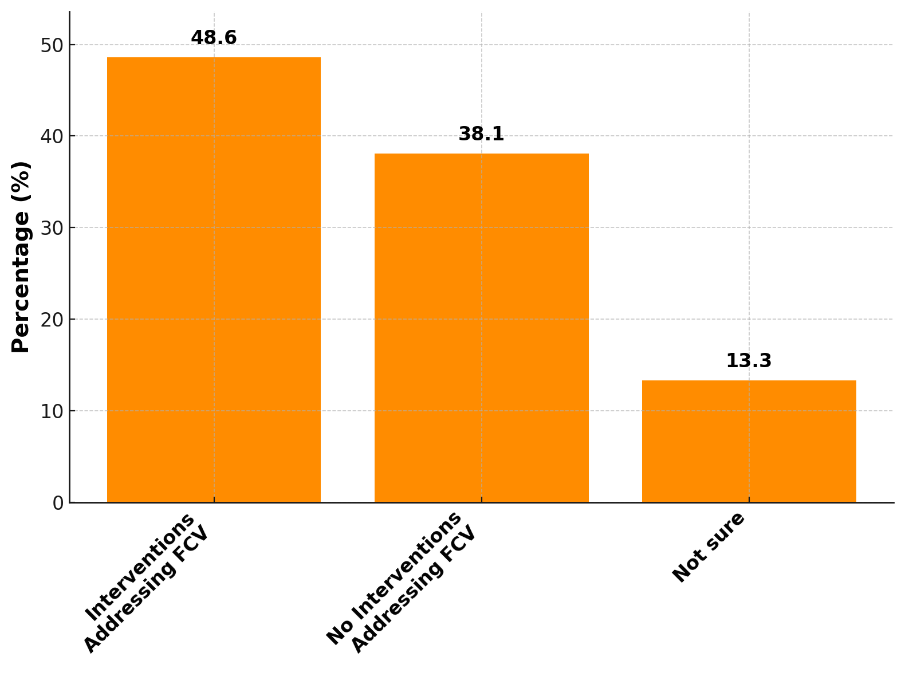
Fragility, Conflict, and Violence (FCV)
Preventive Interventions Addressing FCV
Grassroots Peacebuilding
48.6% of respondents report local interventions like Peace Clubs addressing land and ethnic disputes.
Traditional Leadership Role
Chiefs and religious leaders mediate conflicts, promote cohesion, and resolve leadership disagreements.
CBO and NGO Partnerships
Women’s Advocacy Groups and NGOs like CARE International lead mediation and training initiatives.
Government Initiatives
NCCE and MMDAs implement FCV programmes, promoting peacebuilding and civic engagement.

Slide 9
Binary Logistic Regression Results for Perceived FCV
Variables | Categories | Est. | Std. Error | Wald Chi-Square | p-value | OR | 95% CI for OR Lower | 95% CI for OR Upper | Explanation/Implication
Gender | Male | -1.4 | 0.3 | 6.533 | 0.011 | 0.25 | 0.15 | 0.4 | Males perceive significantly less fragility than females.
 | Female (ref) | 0 | - | - | - | - | - | - | Females are the reference group.
Age Group | 15-35 | 1.5 | 0.28 | 28.643 | 0 | 4.48 | 2.5 | 8 | Younger people (15-35) perceive fragility the most.
 | 36-50 | 0.5 | 0.25 | 4 | 0.046 | 1.65 | 1.1 | 2.5 | Fragility perception decreases slightly with age.
 | 51+ (ref) | -0.5 | 0.2 | 6.25 | 0.012 | 0.61 | 0.4 | 0.9 | Older individuals perceive the least fragility.
Negative Historical Interactions | Yes | 2 | 0.35 | 32.653 | 0 | 7.39 | 3.5 | 15.6 | Tribal conflicts and disputes greatly increase fragility perception.
 | No (ref) | 0 | - | - | - | - | - | - | -
Ethnic Conflict | Yes | 1.5 | 0.32 | 22.023 | 0 | 4.48 | 2.5 | 8 | Ethnic conflicts significantly drive perceptions of fragility.
 | No (ref) | 0 | - | - | - | - | - | - | -
Resource Competition | Yes | 1.8 | 0.4 | 20.25 | 0 | 6.05 | 3.1 | 11.8 | Competition for resources increases fragility perception.
 | No (ref) | 0 | - | - | - | - | - | - | -
Proximity to Border Countries | Upper East | 2.1 | 0.5 | 10.0 | 0.001 | 8.17 | 4.5 | 14.6 | Proximity to the Sahel and internal conflicts contribute significantly to higher perceptions of fragility in Upper East.
 | Upper West | 2.0 | 0.5 | 9.5 | 0.002 | 7.39 | 4.0 | 12.0 | Upper West also reports higher perceptions of fragility.
 | Savannah | 1.9 | 0.5 | 8.5 | 0.003 | 6.7 | 3.5 | 11.0 | Savannah shows elevated fragility perceptions.
 | Northern | 1.8 | 0.4 | 7.8 | 0.005 | 6.05 | 3.0 | 10.3 | Northern region is also a border area with significant perceived fragility.
 | North East | 1.7 | 0.5 | 6.5 | 0.010 | 5.47 | 3.0 | 9.2 | North East shows moderate levels of fragility perception.
 | Oti (ref) | 0 | - | - | - | - | - | - | Oti, as the reference region, reports the lowest perception of fragility.

Slide 10
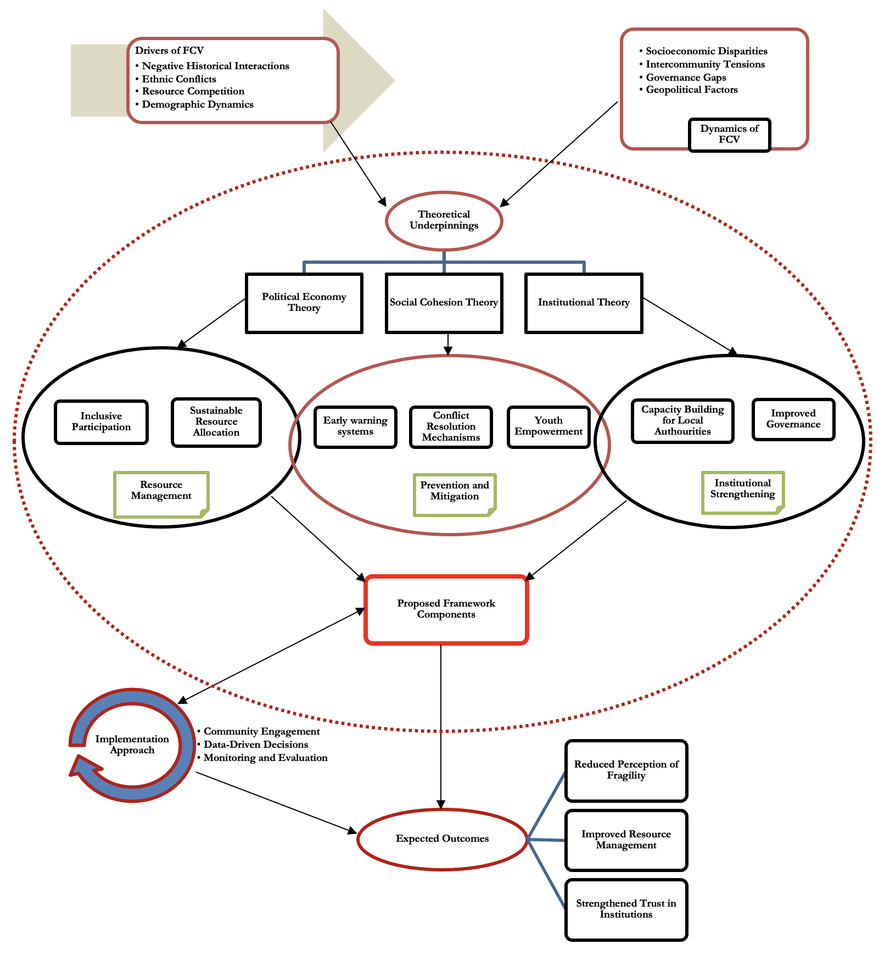
Framework for Addressing FCV in Northern Ghana
Relationship Between the Three Pillars:
Prevention and Mitigation → Resource Management → Institutional Strengthening:
Prevention and Mitigation focuses on early conflict detection and empowering communities, which leads to better resource management practices (e.g., sustainable allocation and inclusive participation).
Effective resource management helps reduce competition over scarce resources and tensions and builds institutional strength through transparent and accountable governance.
Institutional Strengthening reinforces Prevention and Mitigation by equipping local authorities with the tools to manage conflicts and mediate resource-related disputes effectively.
Theoretical Foundation → Practical Application:
Political Economy Theory explains the power dynamics in resource management, guiding the design of fair and sustainable distribution strategies.
Social Cohesion Theory ensures that the framework prioritises community trust, making it a key foundation for Prevention and Institutional Strengthening.
Institutional Theory highlights the importance of strengthening local institutions for long-term conflict resolution and effective resource management.
Implementation Approach (Continuous Cycle):
Community Engagement allows for direct participation from local leaders, CSOs, and the government in implementing the framework, ensuring it is locally driven and context-specific.
Data-driven decisions guide interventions using evidence from surveys, FGDs, and other studies, informing the framework’s actions.
Monitoring & Evaluation helps track progress and refine strategies to ensure continuous improvement and relevance in addressing evolving FCV dynamics.
Expected Outcomes:
Strengthened social cohesion through active participation and improved governance.
Increased resilience to FCV and reduced vulnerability among marginalised groups, particularly women and youth.
Improved institutional effectiveness, ensuring sustainability and stability over time.

Slide 11
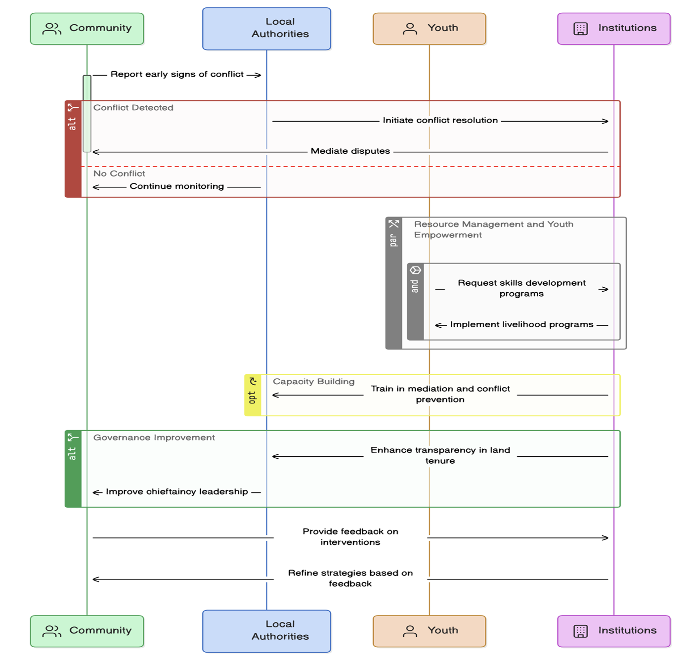
Schematic Framework for Mitigating FCV in Northern Ghana
Conflict Detection & Response:
Communities identify early signs of conflict, enabling prompt action.
Local authorities respond by mediating and resolving conflicts before escalation.
Resource Management & Youth Empowerment:
Sustainable resource allocation prevents competition and reduces tensions over resources.
Youth empowerment through skills and livelihood programs reduces vulnerabilities, particularly to exploitation by extremist groups.
Relationship: Effective resource management and youth programs help stabilise communities, reducing underlying causes of FCV.
Governance Improvement:
Strengthening local governance (e.g., chieftaincy and community leadership) promote trust and fair resource distribution.
Relationship: Improved governance supports effective conflict resolution and strengthens local authority to manage FCV issues.
Institutional Capacity Building & Feedback Mechanisms:
Training local authorities strengthens their ability to manage conflicts and sustain peace efforts.
Feedback mechanisms ensure the framework adapts to community needs and evolving challenges.
Relationship: Continuous feedback and institutional strengthening ensure the framework remains responsive and effective.
Overall Interaction:
The components are interconnected: Conflict detection triggers responses, resource management reduces tensions, governance improvement ensures fairness and institutional strengthening adapts the system.
Goal: Mitigate FCV through coordinated actions across the community, local authorities, youth, and institutions, supported by continuous learning and adaptation.

Slide 12
Recommendations (1/2)
Focus Area | Recommendations
Strengthen Community-Based Conflict Resolution Mechanisms | Increase government and development partner support for local peacebuilding initiatives by providing funding, training, and resources for community leaders, youth groups, and women's organisations to better address local conflicts. Encourage the formalisation of community dialogue platforms to ensure inclusivity and effective conflict resolution at the grassroots level.
Enhance Regional Cooperation for Cross-Border Security and Stability | Strengthen border security infrastructure and promote intelligence-sharing mechanisms among neighbouring countries to combat cross-border extremism and resource-based conflicts. Develop regional peace and security frameworks that involve local governments, traditional leaders, and community stakeholders in managing cross-border tensions. Provide humanitarian assistance and economic support to border communities to mitigate the strain caused by refugees and displaced persons due to regional conflicts.
Increase Institutional Capacity to Address FCV Challenges | Strengthen the capacity of MMDAs to develop and implement FCV-focused interventions in their development plans. Invest in the training of local leaders and CBOs to improve conflict resolution and resource management at the local level.

Slide 13
Recommendations (12/2)
Focus Area | Recommendations
Promote Gender-Inclusive Peacebuilding and Conflict Resolution | Implement policies that promote gender equality in local governance structures, particularly in decision-making bodies related to resource management and conflict resolution. Support women-led peacebuilding initiatives, providing them with training and resources to enhance their capacity in managing conflicts. Ensure that women, youth, and PWDs are included in the planning and implementation of peacebuilding programmes to promote a more inclusive approach.
Improve Resource Management and Equitable Access | Establish community-based resource management systems that involve stakeholders in decision-making processes to ensure equitable access to land and water resources. Promote sustainable agricultural practices and the development of irrigation systems to improve access to water during dry seasons, reducing competition over this critical resource. Address land disputes through legal reforms and local land commissions that provide clear land ownership and conflict resolution guidelines.
Enhance Economic Opportunities for Youth | Expand vocational training programmes that offer practical skills in agriculture, digital literacy, and renewable energy to provide alternative livelihoods. Collaborate with private sector partners to create job opportunities and support youth entrepreneurship in rural areas. Promote youth engagement programmes that involve young people in peacebuilding and conflict resolution, providing them with a sense of purpose and ownership in their communities.

Slide 14
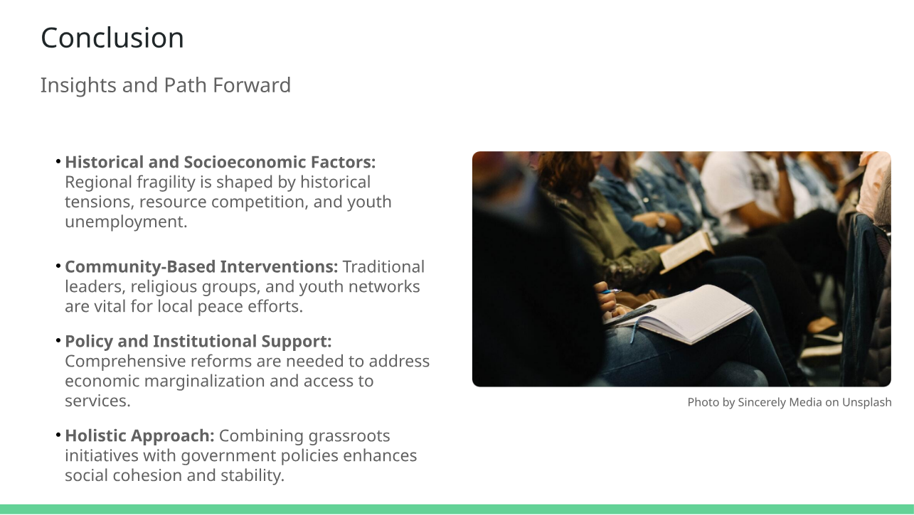

Slide 15


